Slide 1
Support Vector Machines

Slide 2

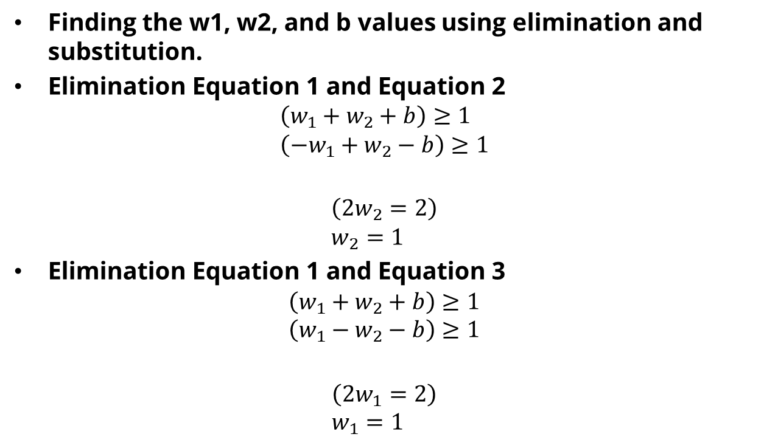

Example
Finding the w1, w2, and b values using elimination and substitution.
Elimination Equation 1 and Equation 2
$$\left(w_{1}+w_{2}+b\right)≥1 \\ \left({−w}_{1}+w_{2}−b\right)≥1$$ $$\left(2w_{2}=2\right) \\ w_{2}=1$$
Elimination Equation 1 and Equation 3
$$\left(w_{1}+w_{2}+b\right)≥1 \\ \left(w_{1}−w_{2}−b\right)≥1$$ $$\left(2w_{1}=2\right) \\ w_{1}=1$$
$$+$$
$$+$$

Slide 3

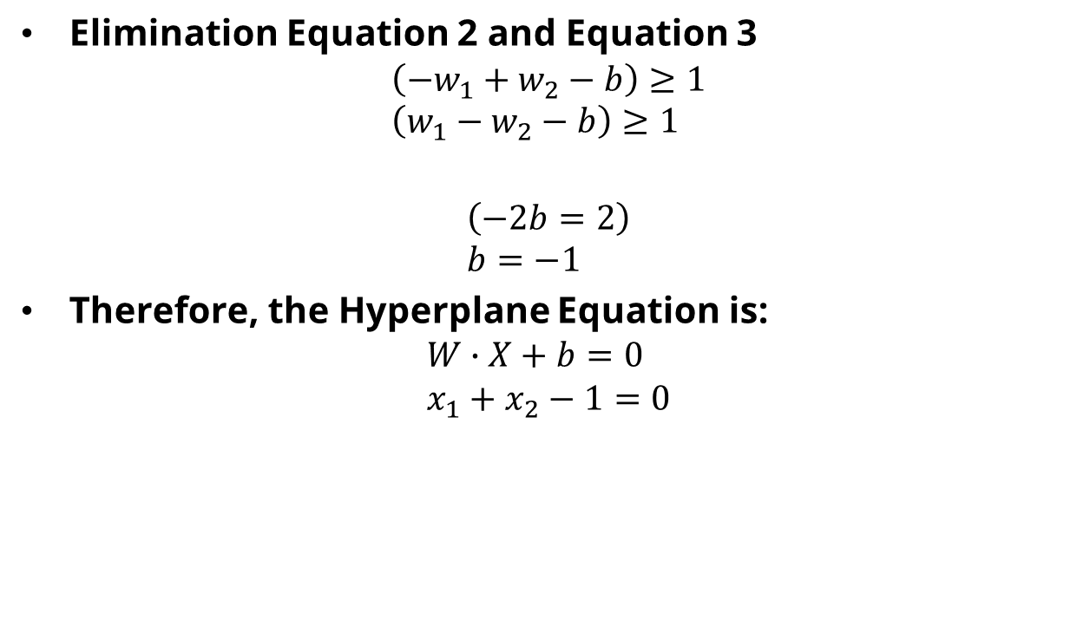
Example
Elimination Equation 2 and Equation 3
$$\left({−w}_{1}+w_{2}−b\right)≥1 \\ \left(w_{1}−w_{2}−b\right)≥1$$ $$\left(−2b=2\right) \\ b=−1$$
Therefore, the Hyperplane Equation is:
$$W∙X+b=0 \\ x_{1}+x_{2}−1=0$$
$$+$$

Slide 4
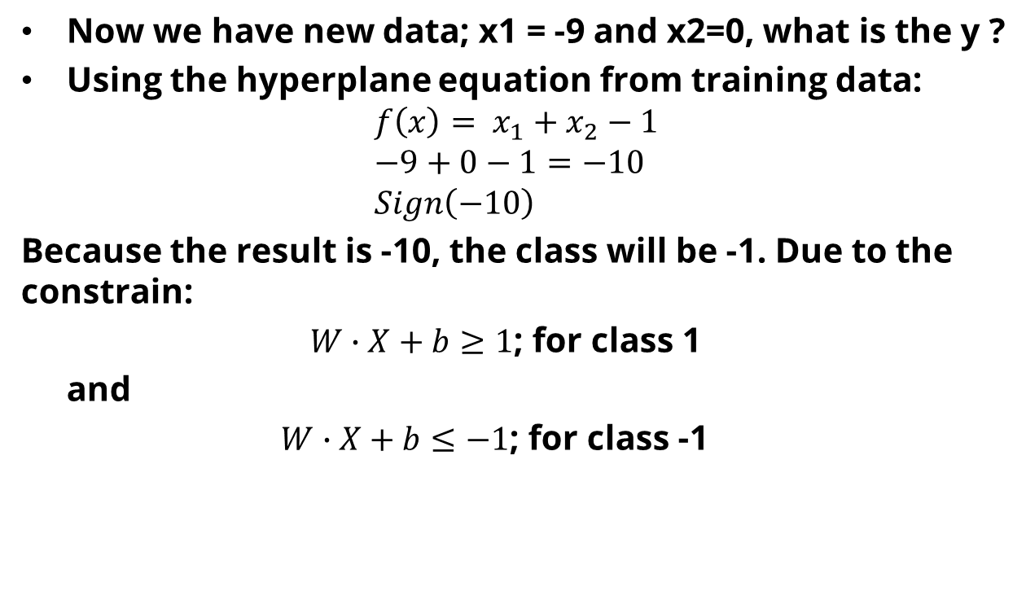
Example
Now we have new data; x1 = -9 and x2=0, what is the y ?
Using the hyperplane equation from training data:
$${f\left(x\right)= x}_{1}+x_{2}−1 \\ −9+0−1=−10 \\ Sign\left(−10\right)$$
Because the result is -10, the class will be -1. Due to the constrain:
$W∙X+b≥1$; for class 1
and
$W∙X+b≤−1$; for class -1

Slide 5
Exercise
x1 | x2 | Y
3 | 4 | 1
2 | 7 | 1
-5 | -2 | -1
-7 | -3 | -1
From above data training, find the hyperplane equation
Assume you have x1= 2, and x2=-1, Determine the class of this new data.

Slide 6
Reference
Siti Aminah, Dina Cahyati, Ari Wibisono, Dhimas Arief, Learning to Classify: the Support Vector Machines. Universitas Indonesia
Andrew Moore and Martin Law. 2022. Introduction to Support Vector Machines. https://cse.hkust.edu.hk/~qyang/221/Lectures/intro%20to%20svm%20221.ppt
https://www.cs.cornell.edu/courses/cs4780/2018fa/lectures/lecturenote09.html

